Slide 1


More.. Beyond the Basics of
scratch.mit.edu
Unplugged Social: Graph Paper programming
Testing your Graph Paper Programming (with Blocks)
Introduce: Lists (and Ninja Challenge!)
Walk through: Cloning
Explore: 3D “Lego Builder” (& Ms PacMan)
Show your projects

Slide 2
Graph Paper Programming
Pair up to do the exercise on paper http://goo.gl/uMpuKp
Both kids in a pair do a puzzle
Switch to Viji’s presentation
Trade papers and execute the other’s instructions
I modeled the exercise in Scratch one evening
http://scratch.mit.edu/projects/17624370
Mentors Viji and Prashanti extended it even more
We’ll use those as springboards for tonight’s topics:
Code Blocks ; Lists ; Clones

Slide 3
Overview: Tonight’s Projects: Graph Paper Solution Tester!
Let’s look at the tester and try your solution
http://scratch.mit.edu/projects/17624370
Ninjas familiar with cloning… try to rewrite this to allow a user to enter the commands when the program is running!
First chat: a new topic: Lists (a short introduction)
Second chat: Change the validator to do a more advanced way of creating the grid (new topic: Cloning)
Related project: 3D fun with learnscratch.org’s Lego Creator
Finally: Show your project!

Slide 4
Let’s use a program to test your Graph Paper instructions
Open http://scratch.mit.edu/projects/17624370/
You can use the keyboard keys to try out your solution
Did you know you can add your very own blocks to your program? Why?
Good for factoring out common chunks of code, or to make a complicated section more understandable
On the cursor sprite, click More Blocks
Drag blocks that you or your partner wrote and test it
To validate via More Blocks, set the size, then (Paint Grid), then double-click the command list you put in.
Be aware that, unlike the answers in the original code.org exercises, you are already on the first square)

Slide 5
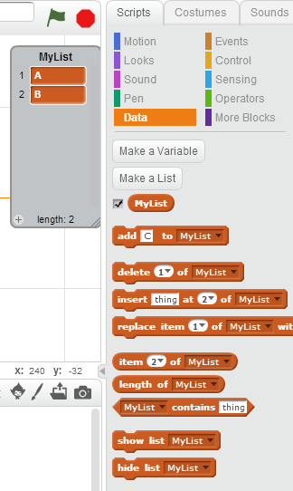
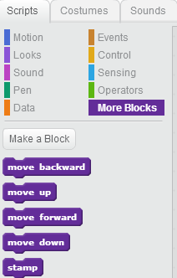
A look at the code blocks
More Blocks
Lists
List Displayed
scratch.mit.edu/projects/17624370
scratch.mit.edu/projects/18080718

Slide 6
Lists are for storing data
You can make a list of constant data.
I’ll add ‘preferred colors’
You can gather a user’s actions for history or to use later
I challenge the ninjas to take the commands that a user enters and execute them, rather than my validator’s ‘put it in the program’
Scratch will show your list on the stage if you have the checkbox checked.

Slide 7
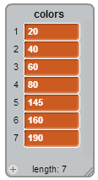
Using a Scratch color list
Scratch has a color value that ranges from 1-200 (or 0-199)
What are the ‘standard colors’? Here’s my list….
http://scratch.mit.edu/projects/18080718
In the ‘simple’ validator app, I just jumped colors by 25 when the user pressed ‘c’, but that skips yellow and gives many shades of blue. Bah.
To control it exactly, I created the ‘colors’ list, and a ‘color_index’ which looped thru (on press of ‘c’)
http://scratch.mit.edu/projects/18081278

Slide 8
Clones – when you want more than one something.
Snowflakes! http://scratch.mit.edu/projects/10463949/
In my validator app, I only used ‘stamp’ to paint
OK, but what if I wanted to edit? Or an ‘undo’ buffer? Or Animation?
Attack of the clones!
Clones can be tricky if you have script on the object.
Every clone will execute the handler events if you’re not careful
Most projects I’ve done with clones ended up creating the max 300 clones
In my final version of my validator, I have ‘clone tests’ , but that feels wrong.
Let’s look at http://scratch.mit.edu/projects/18081278

Slide 9
If you want a challenge Improve the code in http://scratch.mit.edu/projects/17624370/
You can use the arrow keys to go way outside of the painted grid. You might be able to fix this quickly.
You can’t clear and start over. (add a new feature)
(this is just a minor defect) The cursor sometimes changes the ‘white’ color, not the fill.
I’ll give a few minutes to look at the code (of your choice)
Advanced kids who didn’t take on the earlier challenge could refactor the cursor from the ‘fill’ square and eliminate all the tests that forbid the code from running on clones.
If you just want to see my list and clone code, look at
http://scratch.mit.edu/projects/18081278

Slide 10
A fun project from learnscratch.org
This one is just sort of ‘fun’ but since we’ve been looking at a grid..
http://scratch.mit.edu/projects/17192530
Videos are at http://learnscratch.org/sc3-u2/sc3-l9
Suggestions:
The validator program tonight used arrow keys. Modify this to support arrow keys. Or, modify the validator to be in 3D!
Add a 2x2 (square) block in place of the 6x1 block
Make the 3x1 brick two-bricks high and paint a window.
Allow a different size grid and/or make it honor grid boundaries.
User ‘More Blocks’ to simplify

Slide 11
Really just for fun:
The Validator allows you to use keys to move about. There are two types of games that are like this.
Maze: Ms PacMan http://scratch.mit.edu/projects/2630864
Platformer: Donkey Kong: http://scratch.mit.edu/projects/20922/
Platformer: Portal: http://scratch.mit.edu/projects/647875
I would love for you all to find projects that you think are worth mentioning. Next week, we’ll write Asteroids, which covers clones better than this week’s example. If you find a cool project, share it to http://scratch.mit.edu/studios/353977/
If you want to show off your projects, share them to
http://scratch.mit.edu/studios/349617/

Slide 12
Next week: more fun with cloning
Cloning can turn Pong into Breakout
http://scratch.mit.edu/projects/10101023/
Asteroids is a different game, but once you learn cloning, you know all the Scratch you need to do it. (Do you know all the math you need?)
Here’s the starter version:
http://scratch.mit.edu/projects/14542009/
Here’s a mostly finished version:
http://scratch.mit.edu/projects/18041608/

